Slide 1
Installation Guide to Debugger Driver
McMaster Automotive Resource Centre (MARC)
Notes:
HVBMS NXP Tutorials can be found for download from: https://mcmasteru365.sharepoint.com/:u:/r/sites/BatteryWorkforceChallenge-StudentsandManagers-SW2BMSSoftware/Shared%20Documents/SW2%20BMS%20Software/Resources/Archived%20Tutorials/Setting%20Up%20NXP/Tutorial%20-%20HVBMS%20NXP%201.zip?csf=1&web=1&e=RvlWkP This presentation is completed based on “Step 1 - Model_Based_Design_Toolbox_S32K3xx_Series_Quick_Start_Guide.pdf” file, which can be found from Tutorial - HVBMS NXP 1 > S32K - Model Based Design ToolBox after downloading the above .zip file.

Slide 2
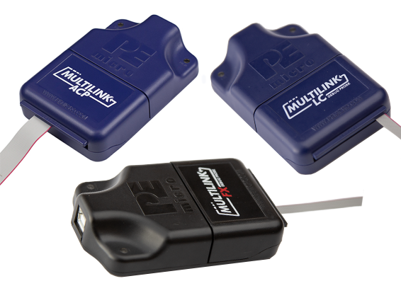
Installation Guide to Debugger Driver
Introduction to the USB Multilink Resources package
The USB Multilink Resources package supports the following probes:
USB Multilink ACP
Embedded Multilink ACP
USB Multilink Universal (all revisions)
USB Multilink Universal FX (all revisions)
Included Resources:
PEFirmwareConfig.exe utility
Technical summaries
Latest firmware updates
Additional support files
Debug Probes

Slide 3
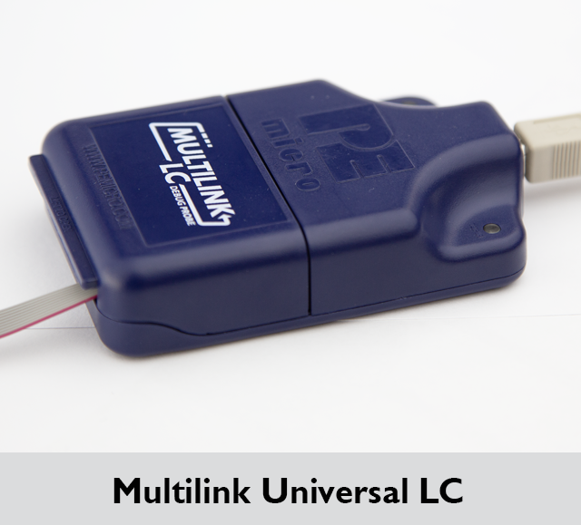
Installation Guide to Debugger Driver
Introduction to the USB Multilink Universal LC
The Multilink Universal LC is an all-in-one debug interface which accelerates the debug and flash programming process, saving valuable development time.
Provides access to debug modes on a wide range of NXP & other ARM Cortex microcontroller families by communicating between the target device, i.e., the MCU on the RD-K358BMU board and a laptop/PC, i.e., a lab computer, via the target’s standard debug header and the laptop/PC’s USB port.
The NXP RD-K358BMU board (the BMU board) has the S32K358 MCU soldered on it, and that MCU is based on the Arm Cortex-M7 core processor.

Slide 4
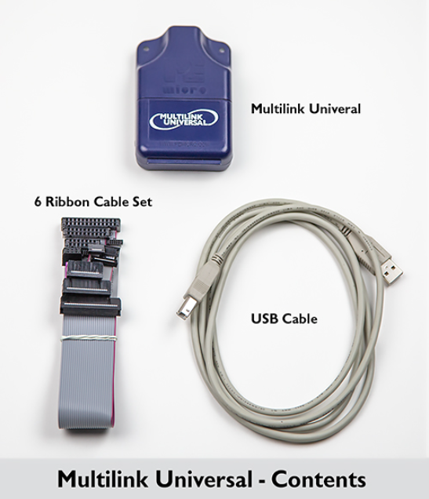
Installation Guide to Debugger Driver
Introduction to the USB Multilink Universal LC

Slide 5
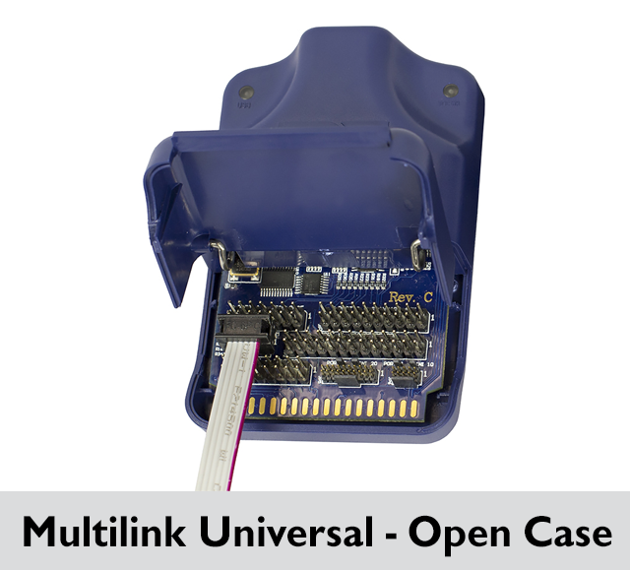
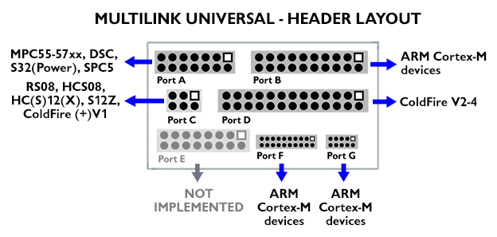
Installation Guide to Debugger Driver
Introduction to the USB Multilink Universal LC

Slide 6
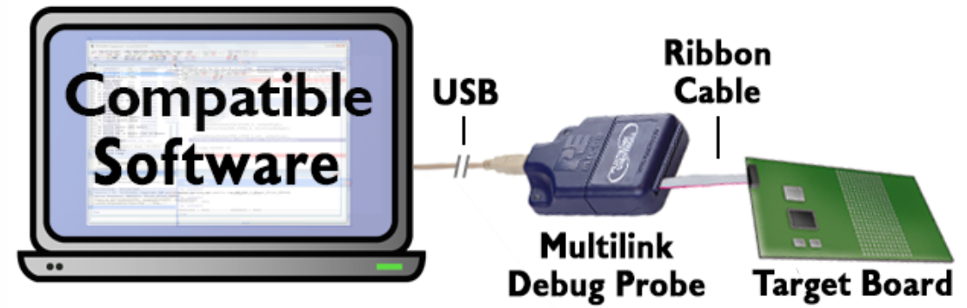
Installation Guide to Debugger Driver
Multilink Debug Probe connections

Slide 7
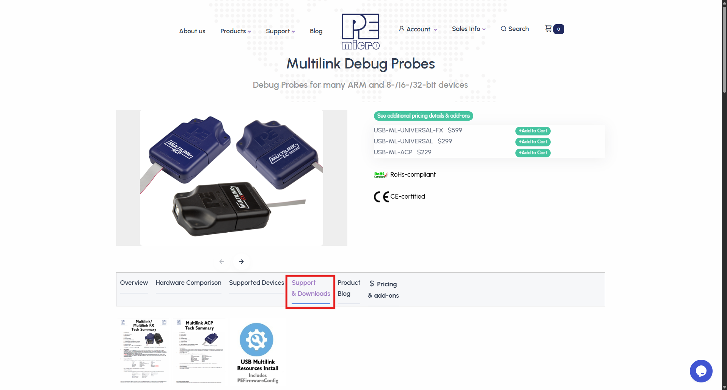
Installation Guide to Debugger Driver
Installation Steps: USB Multilink Resources package
1. First, go to the Support & Downloads page of the PEmicro Multilink Debug Probes. https://www.pemicro.com/products/product_viewDetails.cfm?product_id=15320180&productTab=1000000.

Slide 8
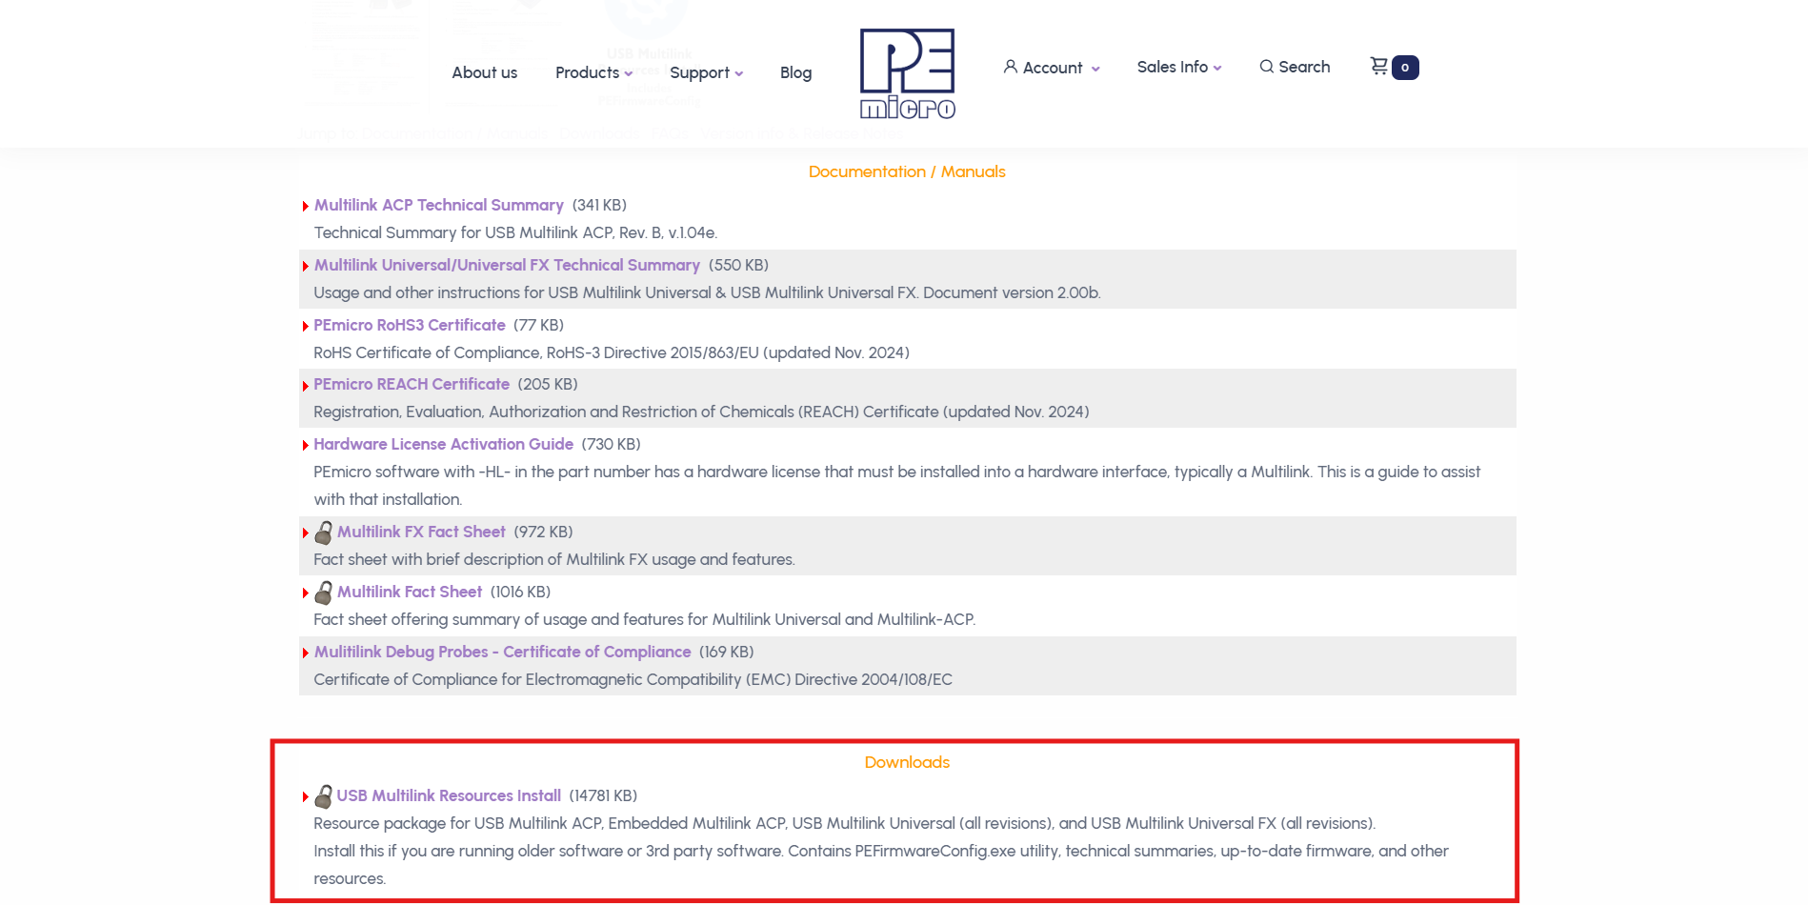
Installation Guide to Debugger Driver
Installation Steps: USB Multilink Resources package
2. Scroll down and stop after reaching the Downloads section.

Slide 9
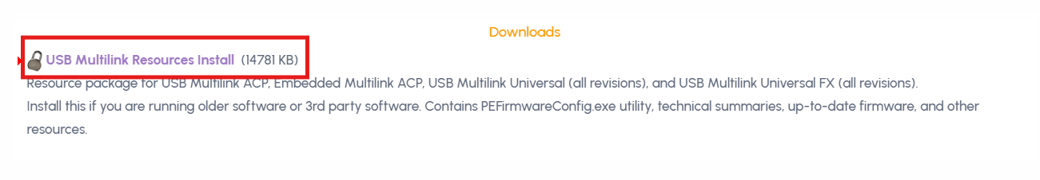
Installation Guide to Debugger Driver
Installation Steps: USB Multilink Resources package
3. Click on the link.

Slide 10
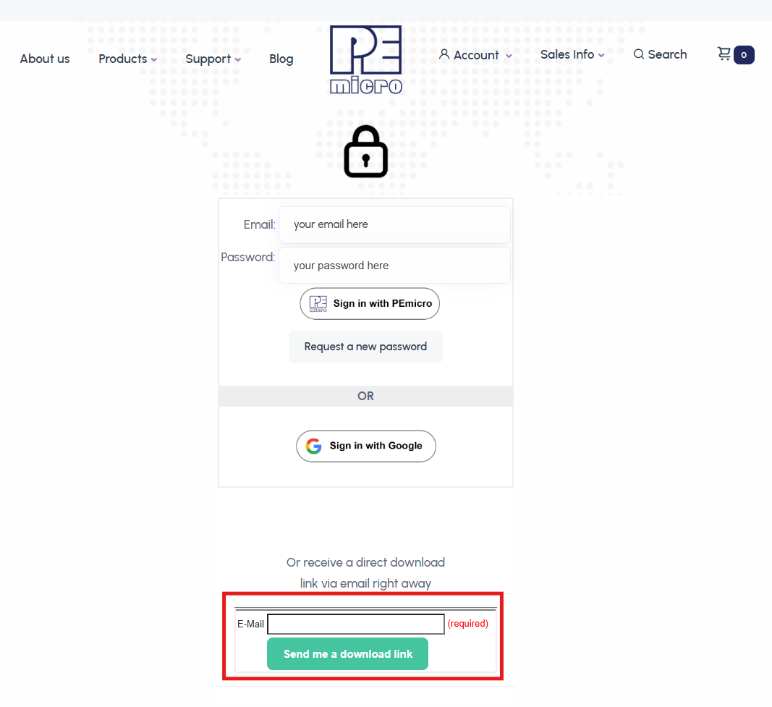
Installation Guide to Debugger Driver
Installation Steps: USB Multilink Resources package
4. If you already have an account with PEmicro, sign in using email address and password. Alternatively, insert your email address, and PEmicro will send a download link in the email inbox.

Slide 11
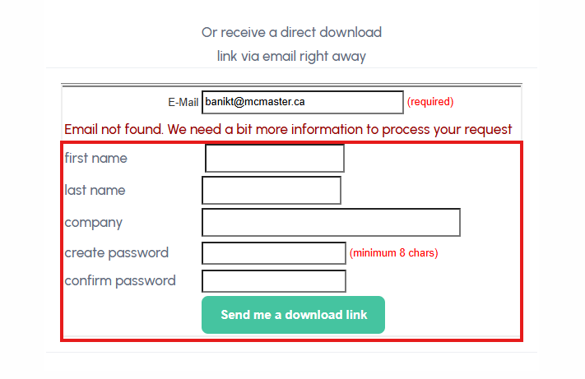
Installation Guide to Debugger Driver
Installation Steps: USB Multilink Resources package
5. Since you have never created a PEmicro account before, you will get the Email not found message. Just fill out the form and press Send me a download link.

Slide 12
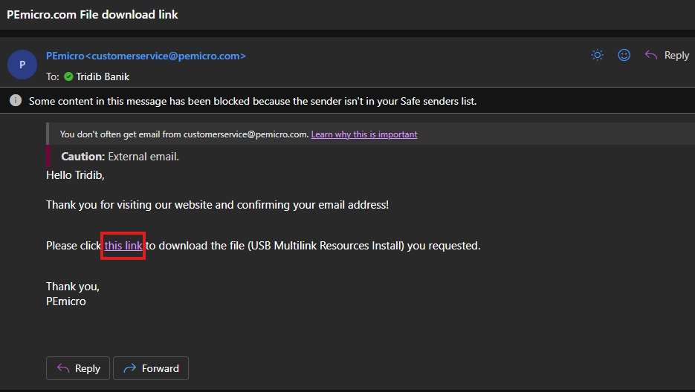
Installation Guide to Debugger Driver
Installation Steps: USB Multilink Resources package
6. Next, open the email inbox and click on the download link.

Slide 13
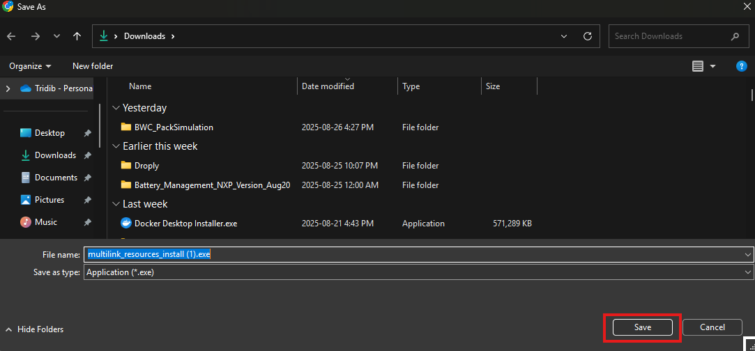
Installation Guide to Debugger Driver
Installation Steps: USB Multilink Resources package
7. Save the executable.

Slide 14
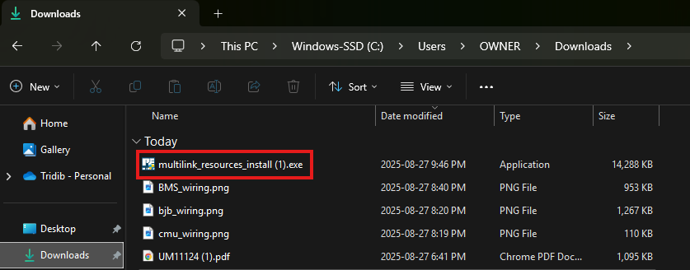
Installation Guide to Debugger Driver
Installation Steps: USB Multilink Resources package
8. Execute it by double-clicking it.

Slide 15
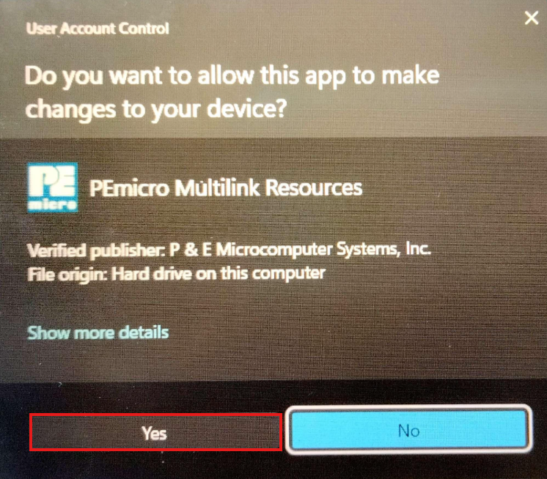
Installation Guide to Debugger Driver
Installation Steps: USB Multilink Resources package
9. Press Yes.

Slide 16
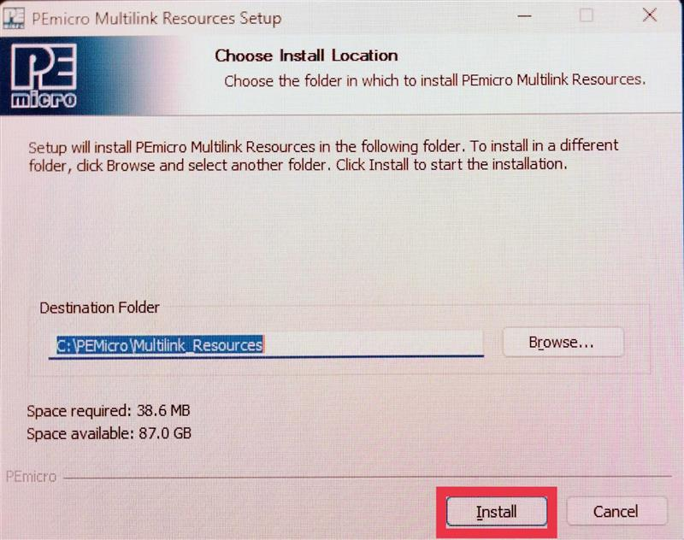
Installation Guide to Debugger Driver
Installation Steps: USB Multilink Resources package
10. Press Install.

Slide 17
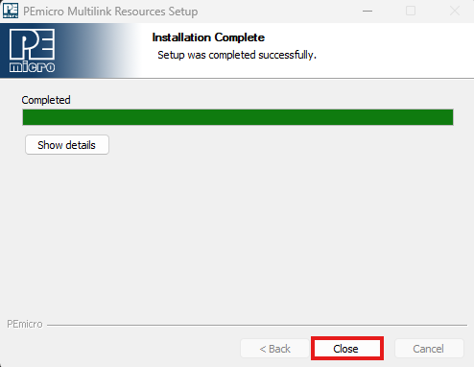
Installation Guide to Debugger Driver
Installation Steps: USB Multilink Resources package
11. Installation is done. Press Close.

Slide 18
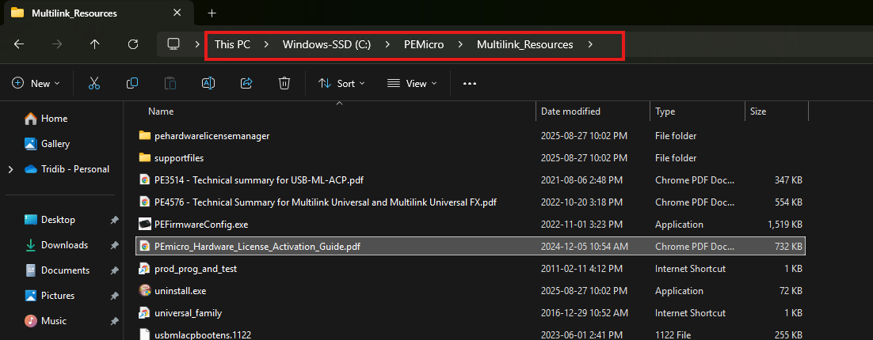
Installation Guide to Debugger Driver
Access to Documentation
For further documentation, navigate to the file path where the Multilink is installed. For example, the default installation path is C:\PEMicro\Multilink_Resources

Slide 19
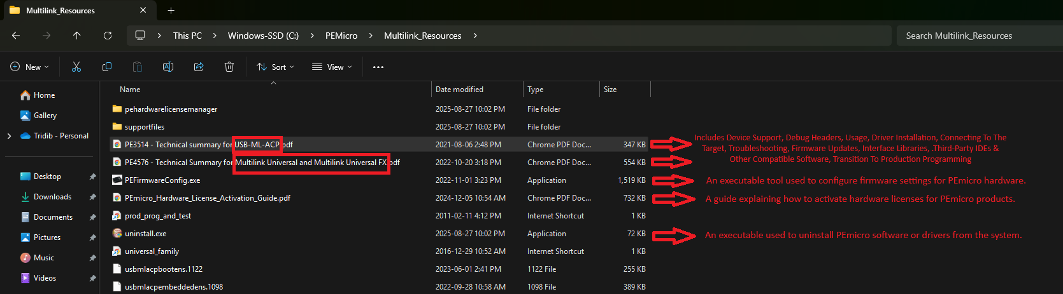
Installation Guide to Debugger Driver
Access to Documentation
An overview of a few files is provided in the screenshot below.

Slide 20
Thank you
McMaster Automotive Resource Centre (MARC)
20

